Slide 1
Midpoint Update
xinru

Slide 2
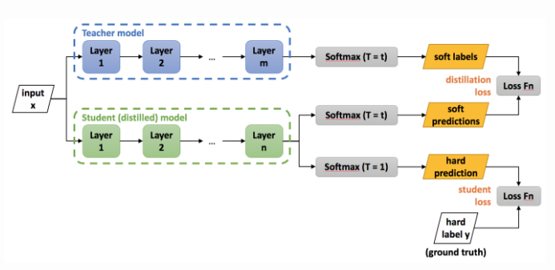
Understand the core concept of Knowledge Distillation

Slide 3
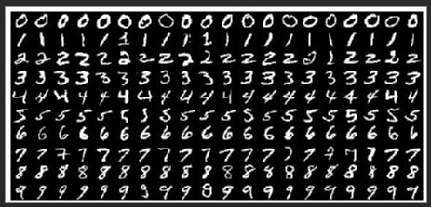
Dataset MNIST
The MNIST database of handwritten digits has a training set of 60,000 examples, and a test set of 10,000 examples.
MNIST Dataset | Kaggle

Slide 4
Teacher Model
linear_net(
(linear_1): Linear(in_features=784, out_features=1200, bias=True)
(relu): ReLU()
(dropout): Dropout(p=0.5, inplace=False)
(linear_2): Linear(in_features=1200, out_features=1200, bias=True)
(linear_3): Linear(in_features=1200, out_features=10, bias=True)
)

Slide 5
Student Model
small_linear_net(
(linear_1): Linear(in_features=784, out_features=50, bias=True)
(relu): ReLU()
(linear_2): Linear(in_features=50, out_features=10, bias=True)
)

Slide 6
Model Accuracy Comparison
Teacher Model (20 epochs)
Train accuracy: 99.66%
Validation accuracy: 98.18%
Test accuracy: 97.84%
Student Model (14 epochs)
Train accuracy: 97.16%
Validation accuracy: 96.64%
Test accuracy: 96.50%

Slide 7
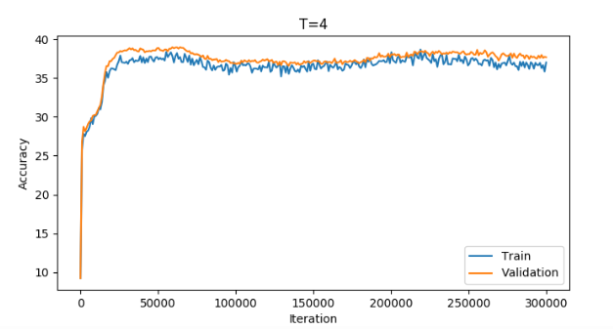
Training graph for student model

